Slide 1
Study on the influence of unsteady state on damage estimation of random vibration loading
Yuzhu WANG¹
Roger SERRA²
¹CARS, Locomotive & car research institute,Bejing, China
²INSA Centre Val de Loire, Laboratoire de Mécanique G. Lamé, Blois, France
Notes:
Mr Mills ladies and gentle, good afternoon
It’s very pleasure indeed for me to give the presentation.
Today I would like to present my work Study on the influence of unsteady state on damage estimation for random vibration loading
I am from CARS, China.
My supervisor, Professor Roger, and I work on fatigue damage from random vibration.

Slide 2
Background and motivation
Why fatigue estimation
Condition Monitoring – Rest life
Life estimation
damage assessment
New challenges, more complex structure, more variable load and more accurate requirements
Notes:
First of all， why we should do the fatigue damage estimation
The purpose of condition monitoring is for security.
For this, we can assume that it is safe when the remaining life of the structure can afford a single operational damage.
Therefore, lifetime assessment and damage estimation are necessary.
The challenge at this stage is, More complex structures, more variable loads, more precise requirements

Slide 3
Background and motivation
Real service load
Random
Non-Gaussian
Non-stationary
Kurtosis increase
Non-Gaussian & Non-stationary
Frequency method
PSD approach
Kurtosis control
Non-stationary index
Kurtosis control
+
Non-stationary index
?
Notes:
Usually, the main load on mechanical structures, especially on transport, is random vibration.
But the real loads are usually non-Gaussian and non-stationary.
For this situation, there are many studies addressing this problem.
For fatigue damage of non-Gaussian random vibration, the method of kurtosis control is usually used, which is based on the original Gaussian random vibration fatigue.
For non-stationary, there are also relevant index of non-stationary.
But here is a problem,
we find that the non-Gaussian random vibration signal, especially when the kurtosis gradually increases, is accompanied by non-stationarity.
So, the problem is coming,
do the kurtosis control and index of non-stationary could solve the non-gaussian and non-stationary fatigue damage estimation?

Slide 4
Problem
The existing non-stationary index are not sufficient to represent the non-stationary state
How does non-stationary effect on non-Gaussian fatigue damage estimation.
Notes:
There are 2 issues to consider here.
First, the existing non-stationary indicators are not sufficient to reflect the non-stationary state
Second, how does non-stationary effect on non-Gaussian fatigue damage estimation

Slide 5
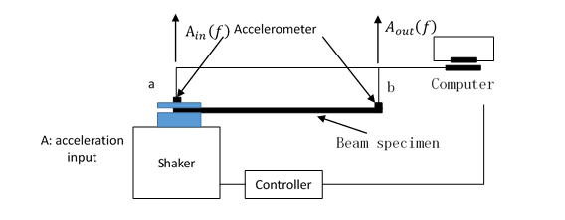
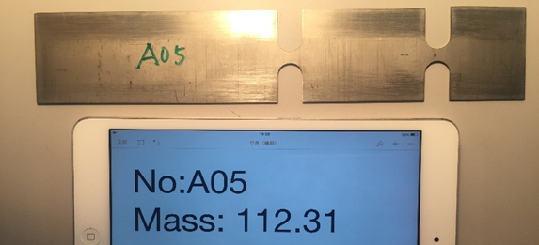
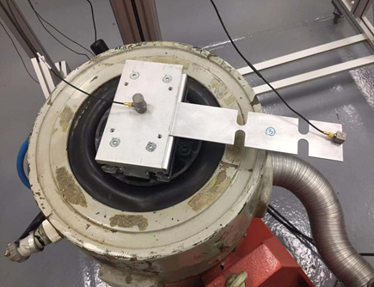
Set-up and specimen design^{[1,2]}
Shaker LDS V650
[1] ASTM E206-72. (1988). ASTM E206-72 (1979) Definitions of Terms Relating to Fatigue Testing and the Statistical Analysis of Fatigue Data (Withdrawn 1988).
[2] Caruso, H. (2001). MIL-STD-810F, test method standard for environmental engineering considerations and laboratory tests.
Journal of the IEST.
Notes:
To investigate this problem, fatigue tests were performed on double-notched beam specimens.
Specific excitations are generated, in the form of the acceleration spectrum, which is applied to the clamping section by the shaker.
2 accelerometers are used to record the input and output signals.
The notch of the specimen is located at the position of maximum displacement to reduce the test time.
To simplify the research process, we used finite element simulations for non-Gaussian random vibrations.

Slide 6
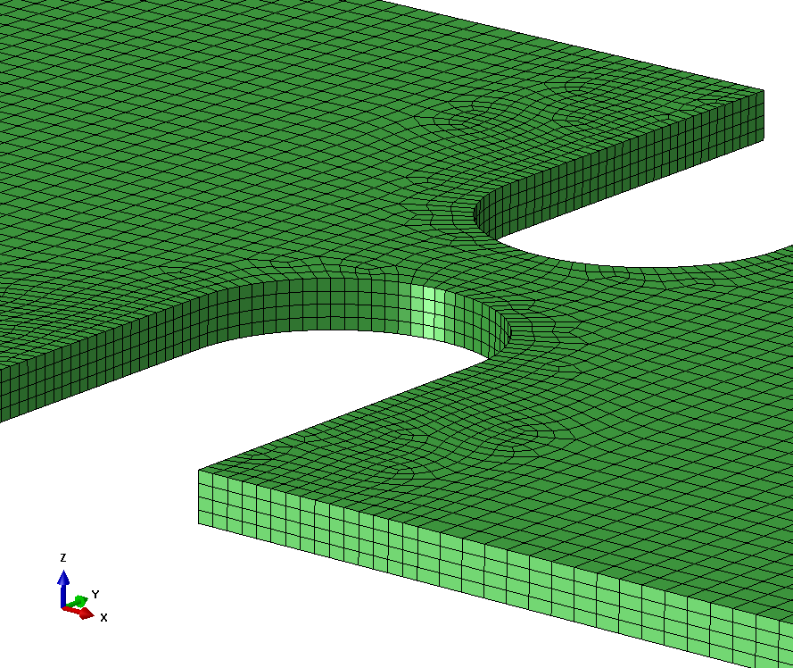
FEM properties of the specimen
FE model (Hypermesh) = Best solution
Element type Solid (8 nodes)
Element size 1mm, 0.5mm (notch)
Thickness 4 elements
Interpolation quadratic
Number of elements
Beam part 80848 Accelerometer 5440
FE modal analysis (Abaqus)
Optimize weight 3:6:1
 | 1st bending mode | 2nd bending mode | 3rd bending mode
Modal analysis | 14.86Hz | 84.67 Hz | 242.8 Hz
FEM before correction | 15.76 Hz (6.06%) | 86.905 Hz (2.64%) | 232.1 Hz (4.41%)
FEM after correction | 15.39 Hz (3.36%) | 85.103 Hz (0.51%) | 226.92 Hz (6.54%)
Before correction
Density | Young modulus
7900kg/m³ | 160 GPa
After correction
Density | Young modulus
7807.04kg/m³ | 158 GPa
The material properties of the specimen are updated.
Notes:
In fact, the main work is done by virtual tests in order to avoid material differences as well as the influence of specimen manufacture and, most importantly, the loading of non-Gaussian random vibrations is very difficult to applied when the kurtosis is very high.
The FEM model is made by hypermesh, the details are as follow.
Modal analysis is used to calibrate the finite element. The calibration is performed according to the 1st to 3rd order modes with different weights. Finally, the density and Young modules are updated, the finite element model is very close to the real situation.

Slide 7
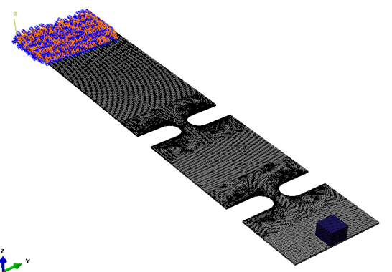
Frequency response function & PSD Stress response
$$A_{PSD}{\left(f\right)}_{output}={\left|H_{A}\left(f\right)\right|}^{2} ×A_{PSD}{\left(f\right)}_{input}$$
A_{PSD}(f) _{input}
S_{PSD} (f) _{output}
A_{PSD} (f) _{output}
H_{A}(f): Frequency Response Function
Frequency range : 48-128Hz
The sample rate is selected at 512Hz
$$S_{PSD}{\left(f\right)}_{output}={\left|H_{S}\left(f\right)\right|}^{2} ×A_{PSD}{\left(f\right)}_{input}$$
Notes:
The frequency response equation of the specimen can be obtained by the modal analysis and the harmonic response analysis.
In this way, we can obtain the response stress and response acceleration of the specimen.
The excitation signal for the test is selected from 48-128 Hz depending on the 2nd mode of the specimen.
Likewise, the sample rate can be determined.
Using this model, the response stresses of the excitation signals with different kurtosis can be obtained for the next step of the study. Here, the response of the system is assumed to be linear.

Slide 8
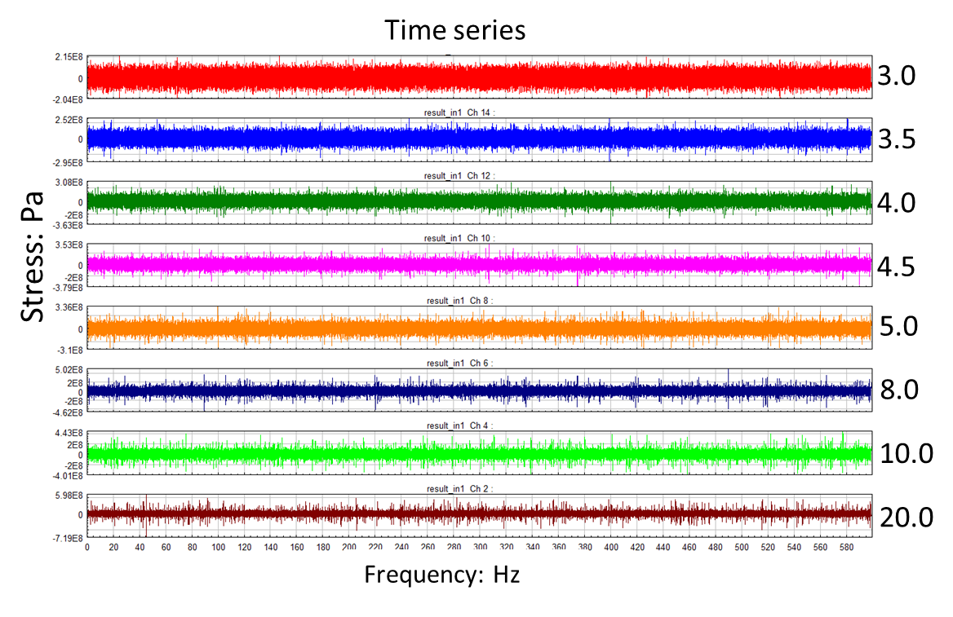
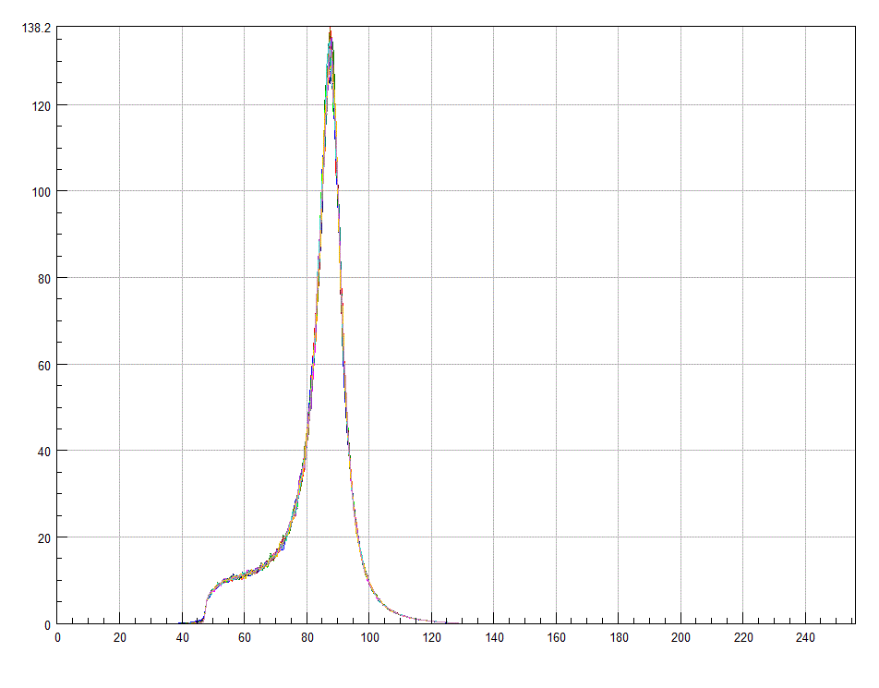
Stress response
S_{PSD} (f) _{output}
PSD: MPa²/Hz
Frequency: Hz
Same mean, same RMS and same PSD
Total 8 kurtosis levels, each level two case
Notes:
Here is the final response stress obtained for different kurtosis excitation signals. The excitation kurtosis ranges from 3 to 20, for a total of 8 kurtosis levels, with 2 cases in each level. They have almost the same statistical information, including mean, root mean square, skewness and kurtosis. But there is a huge difference in the maximum value.

Slide 9
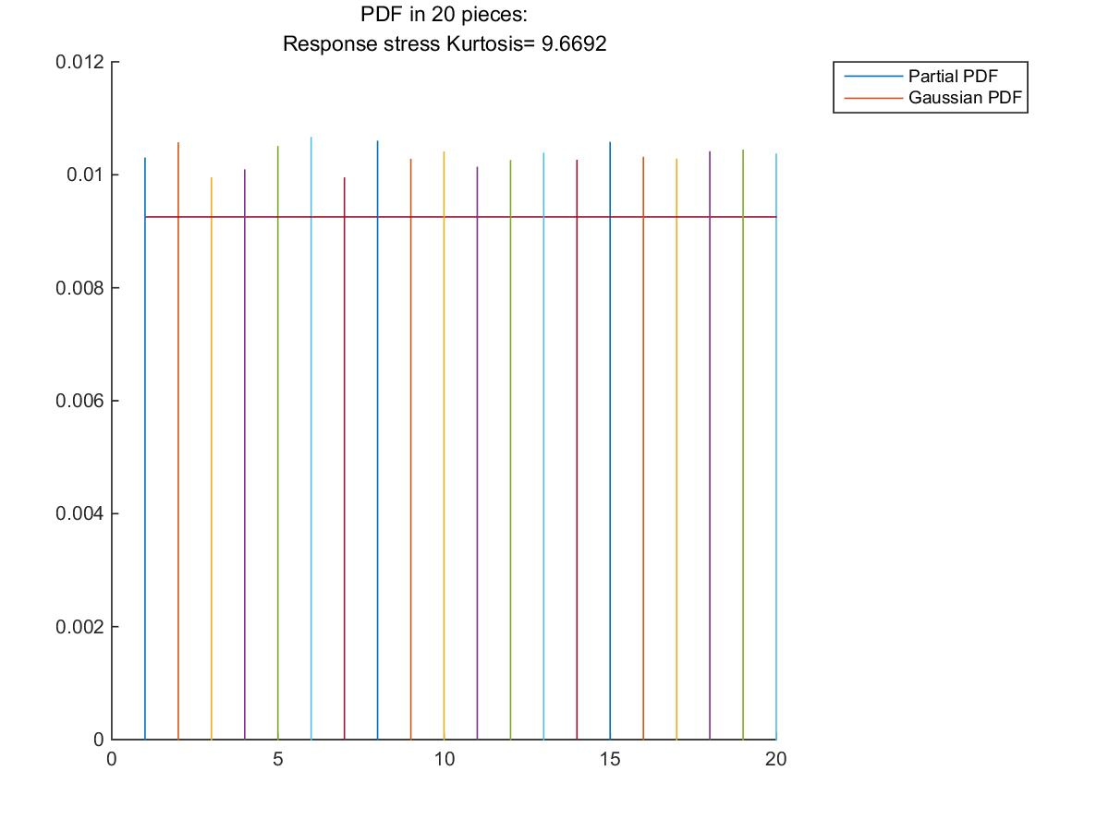
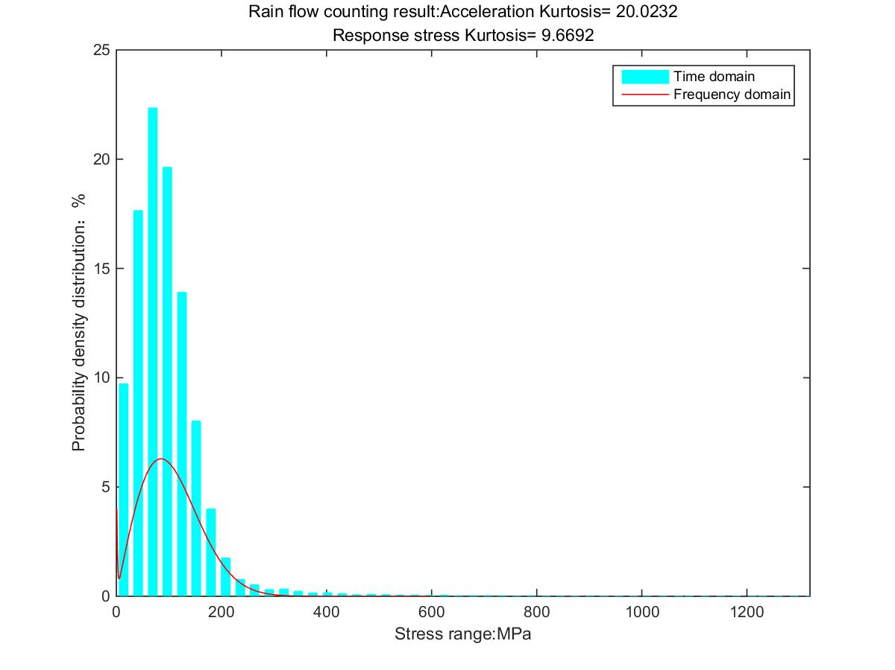
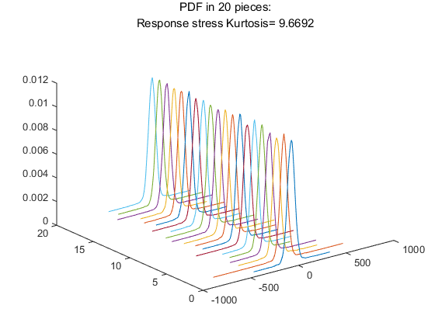
Non-stationary
Notes:
Only the example of maximum kurtosis is used here to demonstrate the degree of non-stationarity of the signal.
This is the time domain sequence of the response stress when the excitation signal is 20.
It can be seen that the kurtosis has attenuated. In fact, the higher the kurtosis, the more pronounced the attenuation.
The time series is segmented and the probability distribution is performed within each section. It can be found that the distribution are different. It is also found that the maximum distribution rate is much larger than the Gaussian distribution.
Finally, the results of rainflow counting are shown, and the biggest difference is the central distribution as well as the maximum stress range compared to the stress cycle distribution obtained by the PSD method.

Slide 10
Non-stationary
The exist index of non-stationary
Kurtosis | γ
20→9.67 | 83.88%
20→9.49 | 85.83%
10→5.63 | 85.83%
10→5.69 | 85.83%
8→4.99 | 91.67%
8→4.84 | 83.88%
5→3.68 | 97.06%
5→3.69 | 88.92%
4.5→3.55 | 90.00%
4.5→3.56 | 88.92%
4→3.40 | 94.59%
4→3.38 | 88.92%
3.5→3.17 | 91.67%
3.5→3.19 | 90.55%
3→2.98 | 90.55%
3→2.98 | 97.06%
Non-parametric method - Run test^{[1,2]}
$$γ=\frac{r}{μ_{r}} [\%]$$
$r$ is number of runs
$μ_{r}$ is mean of runs
$γ$ close to 1 should represent a stationary process
Kurtosis higher, $γ$ smaller
This relationship is not absolute
[1] Nielsen HB. Non-stationary time series and unit root testing 2007
[2] Hory C, Martin N, Chehikian A. Spectrogram segmentation by means of statistical features for non-stationary signal interpretation. IEEE Trans Signal Process 2002;50(12):2915–25
Notes:
This is the more commonly used INDEX of non stationary.
The run test is a qualitative method to judge whether a signal is steady state or not.
From the results, it could be found
When the kurtosis higher, the $γ$ is smaller
But this relationship is not absolute.

Slide 11
The index of non-stationary updated
n windows, $σ_{Sn}^{2}$ is $n_{th}$ variance
Kurtosis | I
20→9.67 | 2.61E-08
20→9.49 | 1.27E-07
10→5.63 | 3.65E-08
10→5.69 | 1.67E-07
8→4.99 | 5.83E-08
8→4.84 | 5.82E-08
5→3.68 | 4.21E-08
5→3.69 | 4.79E-08
4.5→3.55 | 5.36E-08
4.5→3.56 | 7.02E-08
4→3.40 | 1.60E-07
4→3.38 | 7.71E-08
3.5→3.17 | 6.21E-08
3.5→3.19 | 1.11E-07
3→2.98 | 1.11E-07
3→2.98 | 5.59E-08
$$σ_{S_{n}}^{2}=\frac{\sum{{(x−\overline{x})}^{2}}}{n−1}$$
$$σ_{O_{n}}^{2}=\frac{\sum{{(x−μ)}^{2}}}{n−1}$$
$$∆_{1}$$
$$∆_{2}$$
$$∆_{3}$$
$$∆_{n}$$
$$∆_{n}=\left|σ_{S_{n}}^{2}−σ_{O_{n}}^{2}\right|$$
Index I
Index I is variance of $∆_{n}$
I greater, more discreteness
Notes:
Make segments for the time series.
Do the variance for each segment. The variance is also done for the global mean.
Record the difference of the above 2 values for each segment.
For all the difference , do the variance.
This value could reflects the stationary of the data. The larger the value of I, the more discrete the data

Slide 12
The fatigue damage estimation
Wöhler curve
Kurtosis | Damage
20→9.67 | 9.26E-05
20→9.49 | 8.10E-05
10→5.63 | 2.66E-05
10→5.69 | 3.36E-05
8→4.99 | 2.00E-05
8→4.84 | 1.36E-05
5→3.68 | 1.49E-06
5→3.69 | 7.51E-07
4.5→3.55 | 1.52E-06
4.5→3.56 | 2.31E-06
4→3.40 | 1.64E-06
4→3.38 | 2.67E-07
3.5→3.17 | 5.69E-08
3.5→3.19 | 7.71E-08
3→2.98 | 1.04E-09
3→2.98 | 4.80E-10
$$S^{m}N=C$$
Miner law
$$D=\sum{\frac{n_{i}}{N_{i}}}$$
Kurtosis plays a decisive role
Notes:
In this session, the damage of each cases is estimated.
Damage estimation is performed based on the fatigue properties (Wohler curve) of the material and the linear damage accumulation principle.
According to the results, it is found that the kurtosis of the vibration signal greatly affects the damage.
The kurtosis is similar and the damage is similar.
But there are also gap even kurtosis almost same.
This gap increases with the increase of kurtosis.
Why?
non-stationary differences

Slide 13
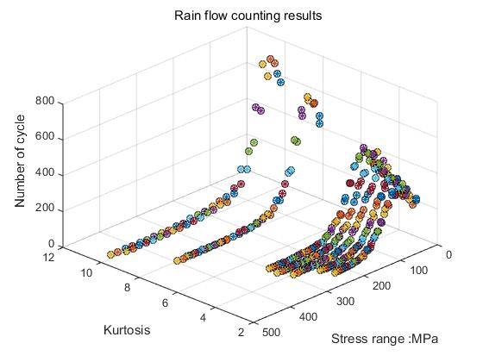
The fatigue damage estimation
Non-stationary effect on non-Gaussian fatigue damage estimation.
$Max$ stress – determined by kurtosis
Area α is determined by non-stationary
Non-stationary
Higher kurtosis - Wider range
More complex distribution
$$\text{W}\text{ö}\text{hler} \text{curve}$$
Bigger stress - greater damage
α
Notes:
This figure is the rainflow result of all case.
The maximum stress range is determined by the kurtosis.
The probability distribution in the alpha region is related to the non-stationary state.

Slide 14
The fatigue damage estimation
${p\left(s\right)}_{NG}=α×{ \left.p(β(s−∆S_{c})\right)}_{G}$ , s ∈[0, σ_{NGmax}]
The non-stationary state will reflect the distribution of red areas, $between$ ${σ_{G}}_{MAX} and{ σ_{NG}}_{MAX}$
Notes:
Using the kurtosis controlled non Gaussian random vibration fatigue damage method, we can get the approximate cyclic stress distribution based on the frequency domain method of Gaussian signal of the same PSD. But for the red area, the distribution of stress, try to establish some relationship, to solve the problem with the non-stationary index.

Slide 15
The discussion of the results
Kurtosis plays a decisive role in random vibration fatigue damage
For the same kurtosis, the smaller the γ, the greater the damage
Kurtosis is the same, γ is the same, the smaller the I, the greater the damage

Slide 16
The work in future
Design experiments to verify the veracity of the above findings.
The relationship between non-stationary and damage was quantified.
Improve fatigue damage assessment for non-Gaussian and non-stationary.
Notes:
I should point out that this work is uncompleted.
In order to improve this method, there is a lot of work needs to be done.

Slide 17
Thank you for your attention

